Slide 1
CER4C3 Abstraction and Paradigms of Programming
Bachelor of Engineering II Year IV Sem

Slide 2
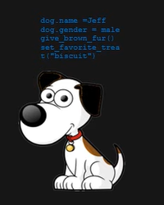
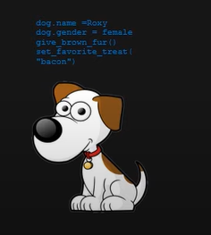
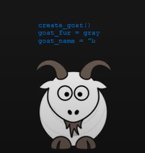
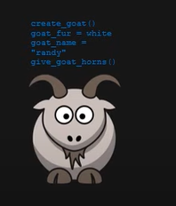
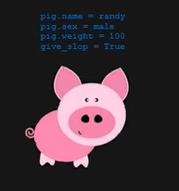
Object Oriented Approach : The Farm Game
Imagine the complexity of such a game with multiple animals of the same species and, a different function for each distinct animal despite of having certain common features.
For every animal the developer would have to start from scratch.
The developer will have to continuously program every feature manually.
If there are large number of animals in the farm this approach will take a large amount of time.
Additionally, what if some bugs are discovered later, in the way the animals are created. The entire code has to be reconsidered.
Hence, This approach for this scenario is not ideal
Infact, That’s the intuition for studying different paradigms. ☺

Slide 3
What would be a better approach ?
What if, rather than then individually programming each animal from the scratch, the developer creates a generalized blueprint of what an animal typically is ? And then apply the same blueprint to every animal that is created.
The basic idea of the object oriented style of programming is the creation and use of these blueprints called classes.
A class is like an abstract blueprint that is used to describe some data with attributes and methods
Once, the class is constructed, instances that inherit from these classes can be created, called objects.
Each instance of a class can pass in data that the object stores and manipulate accordingly.
In this way, we can have multiple entities inheriting from the same class but holding different data.

Slide 4
Coming back to the farm game..
Class Dog {
Dog.breed
Dog.name
Dog.age
Dog.gender
Dog.favourite_food
}

Slide 5
Ease of creating animals with the OOP approach
Dog dog1 = New Dog(“german_shephard”,”Bruno”,1,”pedigree”)
Dog dog2 = New Dog(“Lebra”,”Pluto”,2,”bread”)
Another feature classes have besides storing attributes is methods. Methods are blocks of code within a class that can change the sate of an object.
Let’s say Bruno does not like pedigree anymore, how could I change it.
For this purpose we can add a method to our dog class called change_treat() that will take a new treat as argument and update a dog’s favourite treat.

Slide 6
OOP Approach
void change_treat(new_treat){
Dog.favourite_treat=new_treat
}
This changes the state of an object by changing the object’s attribute.
Now, you can notice that this method is changing the state of something which is outside of its scope.
This is something invalid in functional programming.
For the rest of the animals distinct classes can be created for each of them and if there is any bug or something needs to be changed , you will just have to change the class and the changes will automatically be reflected in the objects.

Slide 7
Procedure Oriented Programming
Procedure oriented programming is a programming paradigm that is based on subroutines or procedure calls also called functions.
They consist of sequential steps that perform some specified task.
Features of Procedure Oriented Programming
Modularity – POP provides modularity, that aims to break down complex programs into smaller modules that have single independent tasks. These modules can later be combined to perform a major task.

Slide 8
Procedure Oriented Programming
Features of Procedure Oriented Programming
Pre-defined functions – Standardized set of instructions defined by a unique name designed to perform particular tasks e.g. printf(), scanf(), getch() in C language etc.
Scoping – Scoping refers to an area within the program where certain variables or functions can be used.

Slide 9
Advantages of POP
Functions – Procedural programming reduces code redundancy through functions. A function once written can be used anywhere throughout the program.
Flow Tracking – Because of sequential or step by step execution the flow of execution can be tracked down easily at any point of time.

Slide 10
Disadvantages
When it comes to large scale project development, the code is not much reusable and therefore, it increases the time and effort required to build large scale applications.

Slide 11
POP V/S OOP
In POP the program is divided into functions that are created for completing certain tasks.
In OOP the programs are divided into classes and objects.
No concept of access specifiers in POP whereas, OOP has three different access specifiers.
Security increases in OOP because of the access specifiers, private members can be accessed by that class only likewise, the protected members can only be accessed by the subclasses.
Data Hiding is a process of combining data and functions in a single unit. The ideology behind data hiding is to conceal data within a class to prevent its direct access from the outside class. OOP supports data hiding through encapsulation. POP does not support data hiding.
Code Reusability is supported to a greater degree in POP as compared to OOP because of inheritance.

